Slide 1
ME-461, Manufacturing Technology, Lecture 2
Date: 5/1/2018
Instructor: Shantanu Bhattacharya

Slide 2
Computer aided design
A large no. of factors are responsible for the success of any engineering organization.
Engineering design of products and processes is one of the most critical factors for success.
Understanding of the design process and the computer aided design tool CAD is required to realize a producible product design.
Computer graphics play an important role in the product development process by generating presenting and manipulating geometric models.

Slide 3
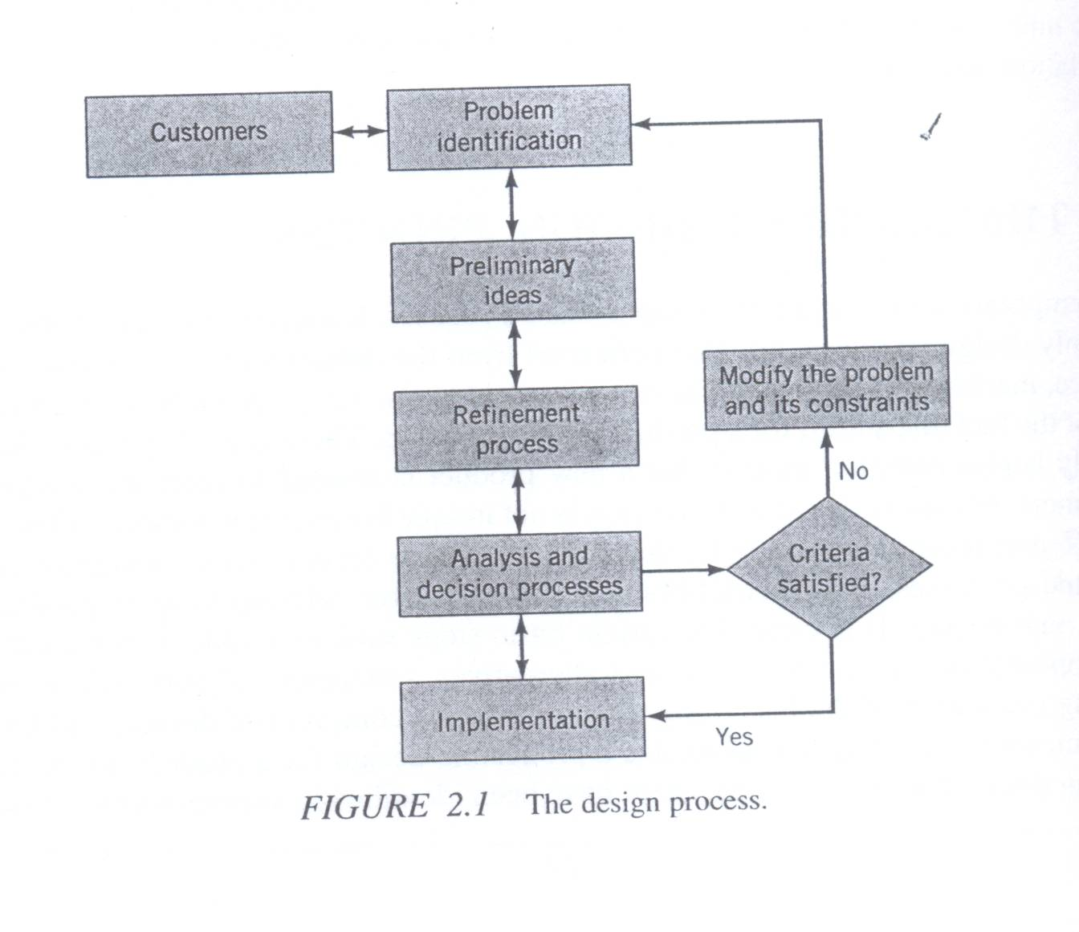
Product design process
Contemporary design is a highly sophisticated process and it requires the involvement of not only design engineers but also personnel from the departments of manufacturing, finance, marketing, and so on.
The primary input to any design process is the recognition of the fact that a need for a product or service exists.
The basic steps involved in the design process are (a) Problem identification (b)Preliminary ideas (c) Refinement process (d) Analysis process (e) Decision process (f) Implementation.
(1)Problem Identification: The key to designing a successful product lies in properly identifying the need and the attributes of that need to which the product is being developed.
Therefore the problem identification process should involve the collection of field data; conducting field surveys and experiments; use of intuition, judgment, and personal observation and physical measurements.
For example: Consider the problem of developing a line of high quality notebook sized computers that will eventually beat the competition. There is a need to identify the characteristics of the product that will be successful in a highly competitive market.
For example the design product should be light in weight, highly portable, self contained, and sized to fit in a briefcase, have a standard keyboard layout feel, and have a compatible operating system, among many other features.

Slide 4
Product Design Steps
(2) Preliminary Ideas: Once the problem domain has been identified, the second phase is to generate as many ideas as possible. Brainstorming sessions should be used to generate solutions to the present problem that may revolutionize present methods. For example: in case of notebook sized computers, consider the possibility of technological choices in very large scale integrated (VLSI) circuits; materials choices and design complexities for price competitiveness; and choices for making the product reliable, testable and producible.
(3) Refinement Process: During the refinement process, several good ideas are pursued, using scale drawings to determine their merits in terms of space requirements, critical measurements, dimensions of structural members, and interactions of surfaces and planes.
(4) Analysis Process: The analysis phase is concerned with the evaluation of best designs from the point of view of a number of criteria such as cost, functional requirements, and marketability. Other engineering tools such as finite element methods and assembly analysis tools should be used to evaluate alternative designs from the functionality point of view.

Slide 5
Product Design Steps
(5) Decision Process: Most often a product is ultimately manufactured using a single design. Therefore there has to be a decision phase of the design process wherein a design that has all desirable characteristics is selected with the following attributes:
(a) Manufacturable at minimum cost.
(b)Design with all desirable quality built-in.
(c) Design that can be quickly manufactured to make the product available to the customers faster.
(6) Implementation process: This step is essentially a detailed design phase. The detailed specifications of materials, dimensions, tolerances, and surface roughness should be provided. The idea is to make the drawings to be used directly for developing process plan so that the product can be manufactured.

Slide 6
A brief history of CAD
Automotive and aerospace industries have been at the forefront of development of CAD technology.
Its origin however can be traced back to Ivan Sutherlands thesis in 1963 describing a system called sketch pad.
The system known as sketch pad is now known as interactive graphics and was developed under the SAGE (semi automatic ground environment) project.
It helped change the radar information into computer integrated pictures and allowed the flexibility of choosing the information by pointing a light pen at the desired location on the cathode ray tube display.

Slide 7
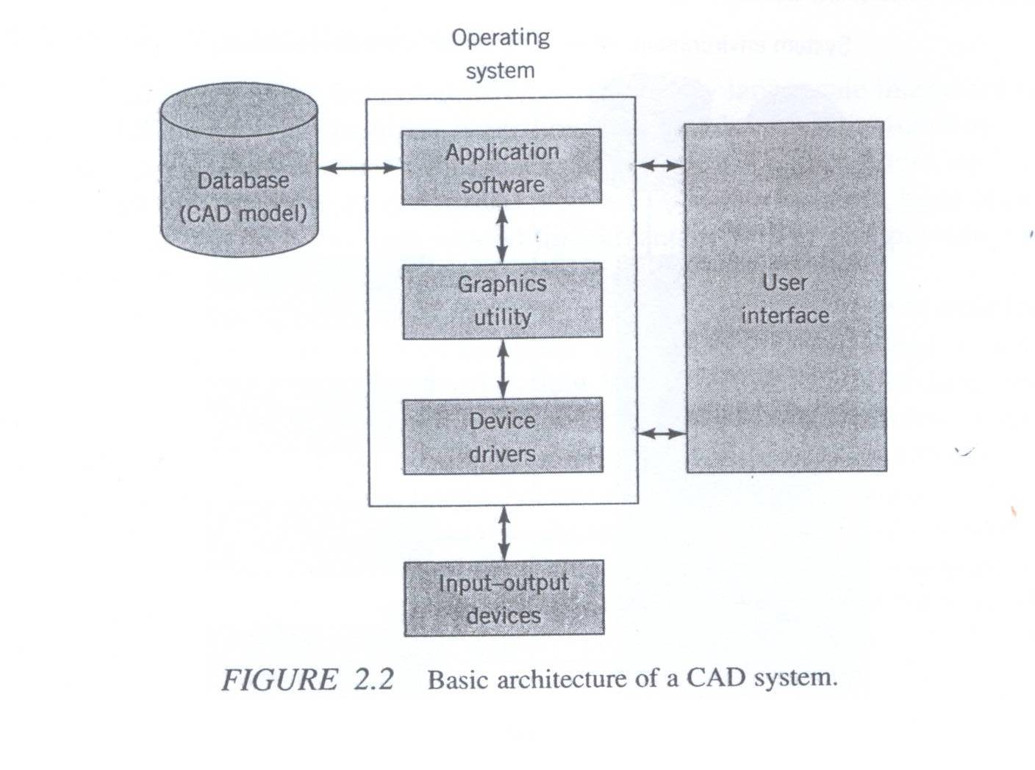
CAD/CAM systems
A wide variety of CAD/CAM systems are currently available.
Essentially a CAD system comprises of three major components: Hardware, which includes computer and input/output devices, application software, and the operating system software.
The operating systems software act as the interface between the hardware and the CAD application software system.
The classification scheme we use in this section is based on hardware of the system.
More specifically, we classify systems by the host computer that drives the system.
Generally, CAD/CAM systems are classified into four types:
Mainframe Based systems
Minicomputer based systems
Workstation based systems
Microcomputer based systems

Slide 8
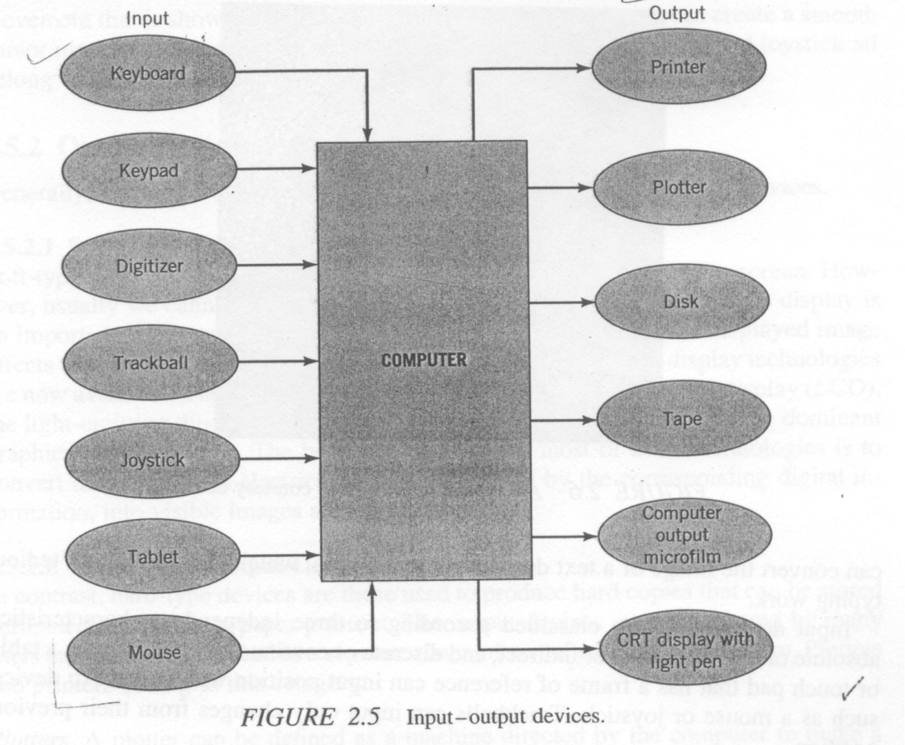
Input output devices

Slide 9
Introduction to Geometric Transformation
Computer graphics plays an important role in the product development process by generating, presenting, and manipulating geometric models of objects.
During the product development process, for proper understanding of designs, it is necessary not only to generate geometric models of objects but also to perform such manipulations on these objects as rotation, translation and scaling.

Slide 10
Introduction to Geometric transformation
Essentially, computer graphics is concerned with generating, presenting and manipulating models of an object and its different views using computer hardware, software and graphic devices.
Usually the numerical data generated by a computer at very high speeds is hard to interpret unless one represents the data in graphic format and it is even better if the graphic can be manipulated to be viewed from different sides, enlarged or reduced in size.
Geometric transformation is one of the basic techniques that is used to accomplish these graphic functions involving scale change, translation to another location or rotating it by a certain angle to get a better view of it.

Slide 11
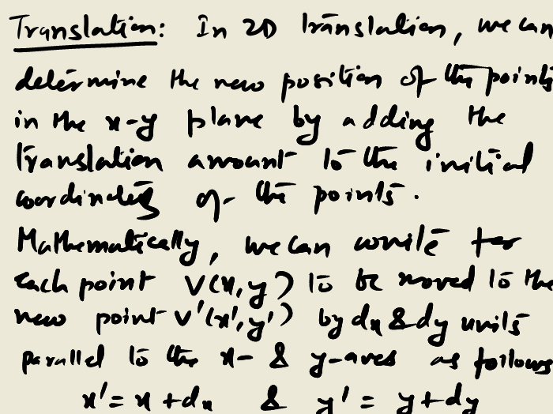
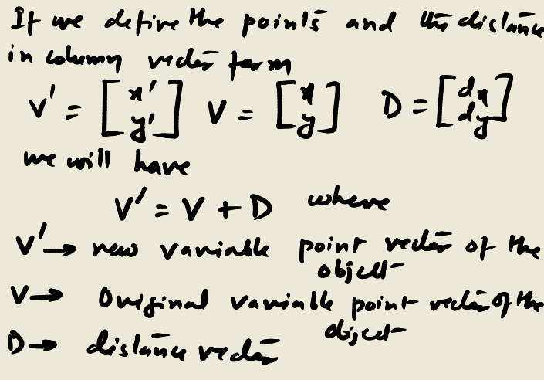
Geometric Transformation
Two dimensional transformation:

Slide 12
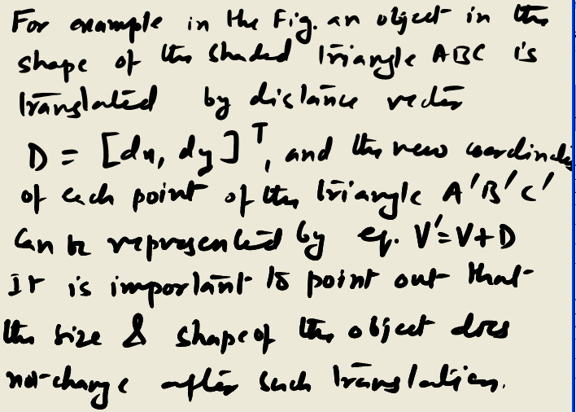
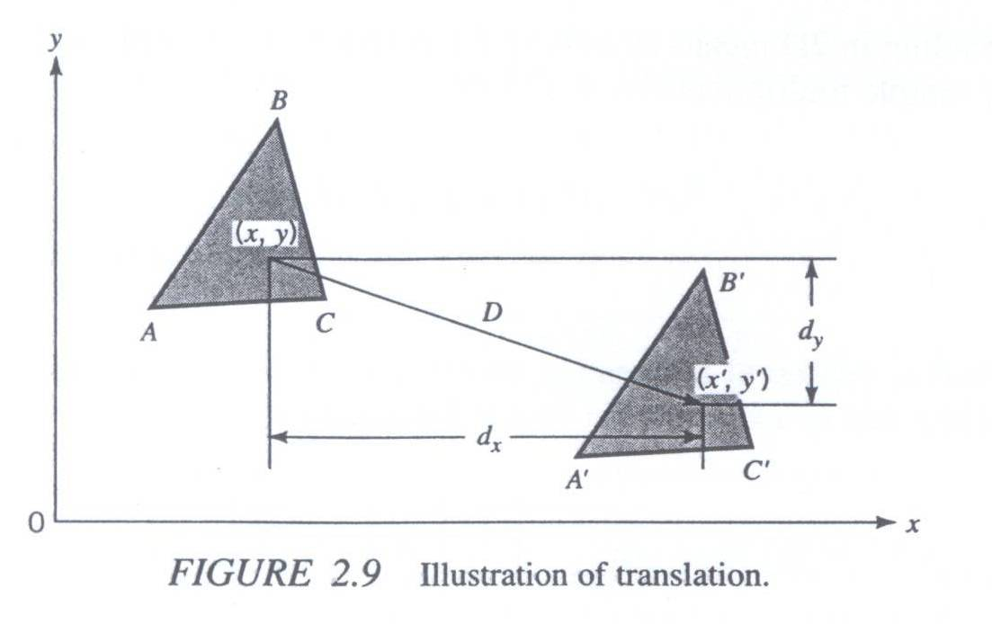
2-D transformation
Example : In the figure above, suppose the initial coordinates of vertices A,B,C are (1,3), (4,5), and (5,3.5), respectively. Determine the coordinates of new vertices A’, B’ and C’ after translating the triangle by a distance D= [7, -2]^{T} (where T represents transpose). Verify that the lengths of the edges of the triangle are unchanged.

Slide 13
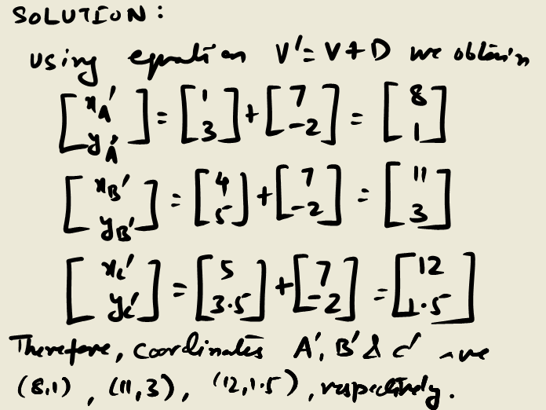
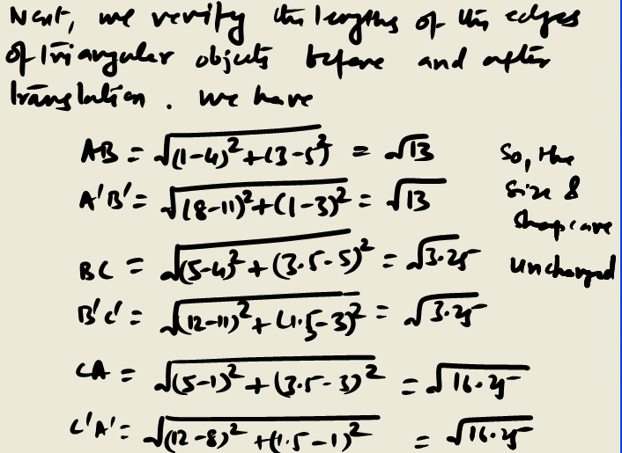
2-D transformation

Slide 14
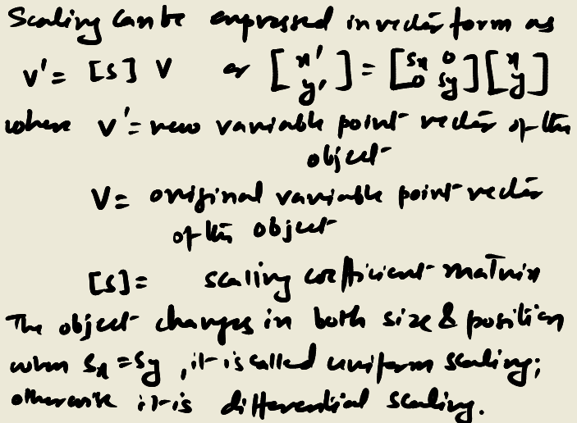
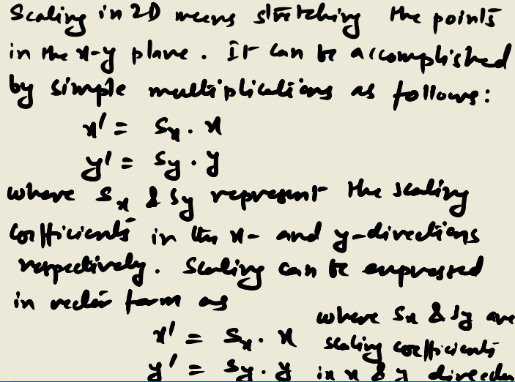
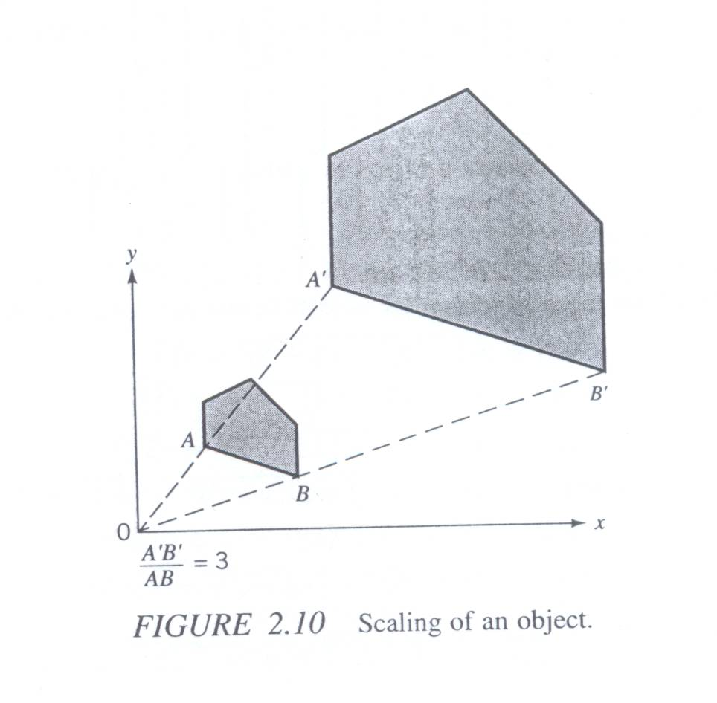
2-D transformation
Scaling
Example: From the figure on the right, show that the length of the edge A’B’ is equal to three times that of AB after scaling the object uniformly by factor 3.

